Slide 1



Funded by the European Union under the Grant Agreement n°101129493

Slide 2
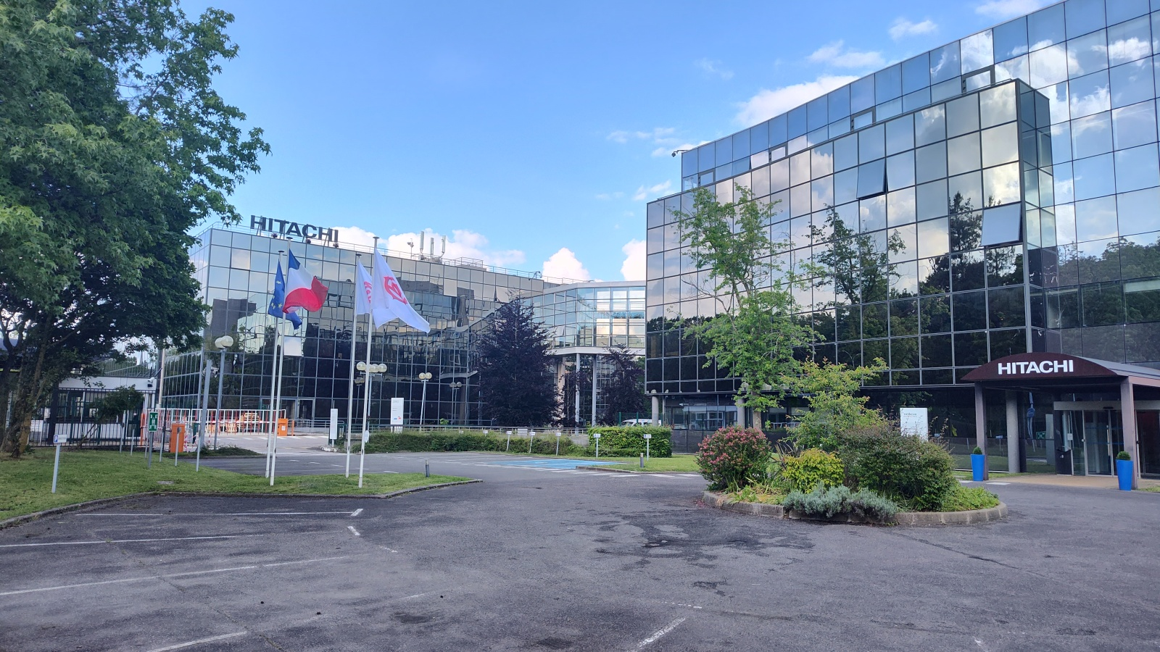
WELCOME

Slide 3

Schedule | Topic | Speaker
08:30 - 09:00 | Registration and welcome coffee
09:00 - 09:20 | Welcome speech and introduction | SNCF Réseau / Hitachi GTS Pierre LE CORRE / Christophe VITRY
09:20 - 09:40 | Interest of FRMCS for the railway sector | EY – Rik NEIRYNCK
9:40 - 10:00 | NTN communication | ERJU / 6G SNS Léa PATIES / Oana RADU
10:00 - 10:20 | Coffee break (30')
10:20 - 10:50 | Industrial SatCom evolution | EUTELSAT – Drew BRANDY
10:50 - 11:10 | IRIS2 - European action | DG DEFIS – Giuditta MONTESANTI
11:10 - 12:00 | Roundtable - Opportunity of SatCom for critical rail services | UIC – Guillaume GACH Hitachi GTS – Andrew HUNTER Danmarks Tekniske Universitet – Lars DITTMANN DLR – Benjamin BARTH
 | EUSPA - EU SATCOM WG | EUSPA – Daniel LOPOUR
12:00 - 14:00 | Lunch / Visit of the Hitachi GTS showroom
14:00 | Reminder of S5LECT use case | S5LECT team
 | Data acquisition compaign and results
 | Coffee break (20')
 | S5LECT Lab demonstration
 | Project conclusion and perspective
17:00 | Closing speech | EUSPA / SNCF Réseau
17:00 - 19:00 | Consortium meeting - Official final review | Not open to public audience

Slide 4

Context
The S5LECT project has been submitted to a EUSPA Call: HORIZON-EUSPA-2022-SPACE.
Purpose :
  Supporting the creation of commercial solutions for the EU space downstream sector.
Topic description : GOVSATCOM (« Research and Innovation Actions », RIA) :
  Aims to provide safe and efficient means of communication to critical safety and security missions and operations managed by the EU and its Member States.

Slide 5






  Key information
Experimenting a solution for seamless handover between 5G terrestrial networks, satellite link and GSM-R communication system.
Objectives
€ 1 938 382,50
Budget
      dget
30 months
Starting date : 01/03/2024
      Duration
Duration
Project start : 2
Expected by project end : 4
TRL

Slide 6
  Objectives of the project
Obj1: Definition of the applications requirements and specific railway scenarios for the use of a combination of satellite and terrestrial radio access technologies
Obj2: Design, implementation, and validation of innovative solution for seamless handover between 5G terrestrial network, Satellite link and GSM-R
Obj3: Analysis of the cybersecurity risks associated to the use of satellite communications for critical and noncritical railway applications.
Obj4: Design, implementation, and evaluation of Edge Computing technology for critical railway applications in the context of satellite communications
Obj5: Development and integration of the different bricks for the S5LECT Testing Lab
Obj6: Proof of concept of the technical solution in the S5LECT laboratory

Slide 7

THANK YOU

