Slide 1

S5LECT final event
07 October 2026
Léa Paties
Senior Programme Manager

Slide 2
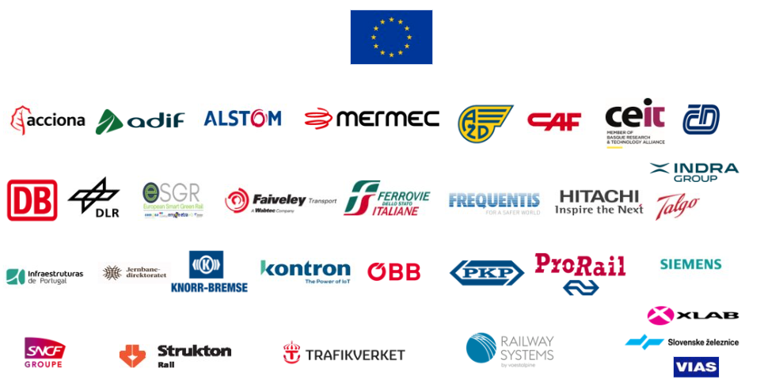
About Europe’s Rail
Established
November 2021
(Council Regulation
EU 2021/2085)
as a Joint Undertaking –
a body of the EU
Governance
Governing Board with
Main advisory groups: State
Representatives Group,
Scientific Steering
Group
Public Partner
European Union,
represented by
European Commission
Private Members
29 members
representing
full rail value chain

Slide 3

Single R&I Programme based on a system view
DEPLOYMENT GROUP
SYSTEM
PILLAR
CONTINUOUS EXCHANGE
INNOVATION
PILLAR
Single governance and coordination body
Functional system architecture
User-focused
Research & Innovation
Flagship Projects
Unified operational concept
Support Single
European Railways
Area
Large-scale demonstrations.
Exploratory, fundamental R&I
Common
EU railway system view
Technological and operational
solutions

Slide 4













EU-RAIL PROGRAMME
Innovation Pillar
Network management planning and control & Mobility Management in a multimodal environment
Digital Enablers
Network management planning and control (new processes and automation for decision support) & rail management in a multimodal environment (real-time demand-driven operations, including demand from other transport modes)
FA1 - TMS+
Transversal Topic
Provide Digital Twins Design toolbox for design as well as for validation, verification and test + a Federated dataspace where all digital elements of the system can play together in a coherent and interoperable way
Digital & Automated up to Autonomous Train Operations
FA7- new approaches
Innovation on new approaches for guided transport modes
FA2 - ATO+
Digital “Automated & Autonomous” Train Operations building upon the next gen Automatic Train Control based on ERTMS + enhancements on TCMS for integration at the on-board level
Explore non-traditional and emerging flexible and/or high-speed guided transport systems, as well as to create opportunities for innovators to bring forward ideas for shaping those future systems
Intelligent & Integrated asset management
+ Exploratory Research and other activities
FA3 - Assets Mngt
FA6 - Regional services
Knowledge from the digital transformation will feed back into the design, construction, manufacturing as well as into operation and maintenance processes.
Decreasing cost while offering a high quality of service and operational safety + increase customer satisfaction and attractiveness
A sustainable and green rail system
FA4 - Green Solutions
FA5 - Freight
Sustainable Competitive Digital Green Rail Freight Services
Innovative solutions and services based on leading edge technologies to minimize the overall energy consumption and environmental impact of the railway system
Digitalization and automation of operational functions (e.g. DAC) and processes as well as increasing the efficiency of the immaterial (information/data) layer of transport in logistic

Slide 5
SATCOM Rail Experts Group | The mission
Teaming by experts from: Commission – MOVE and DEFIS, ERA, EUSPA, EU-RAIL (Flagship Area 2 and 6)
Gather requirements and use cases where satellite communication is possible/necessary for all technologies being developed in EU-Rail and EUSPA projects.
Facilitate communication between EU-Rail with EUSPA and other institutions (DG DEFIS, DG MOVE), agencies (e.g. ERA) and organizations of interest in rail related EU SATCOM use cases
Technical and economic feasibility advice for the development of demonstrators that can be enhanced by satellite communication.
Serve as a driving force for implementing satellite communications, to support broader use cases that enable modern safety systems or passenger services

Slide 6
SATCOM Rail Experts Group | State of play
Characterisation of EU SATCOM (GOVSATCOM and IRIS2) into the European railway system → identification of areas for assessment
Gather requirements and use cases where satellite communication is possible/necessary for all technologies being developed under the concerned EU-Rail flagship areas and EUSPA projects. Sharing of outcome from ongoing projects (FP2 and FP6) for both interoperable and not interoperable domains.
Assessment of potential synergy with ongoing joint railway/space shared initiatives (including ESA ones)
Exchange with technical experts from space and rail is scheduled to discuss the identified gaps with regards to requirements and traffic assumptions coming from previous projects.
Discussion on a first draft Work Breakdown Structure for the group is under discussion which should base on the feedback of the technical exchange, the work should include as basis for a shared time/resources/outputs work plan:
  Requirements collection and consolidation
  EC/EUSPA Technical Assessment of requirements
  Technical Validation (via FA2, FA6 demonstrators)
  Synthesis, Recommendations and Roadmap
InnoTrans 2026, high level session on “Space Meets Rail: Unlocking Satellite Communications for Europe's Railways” and discussing the next steps

Slide 7
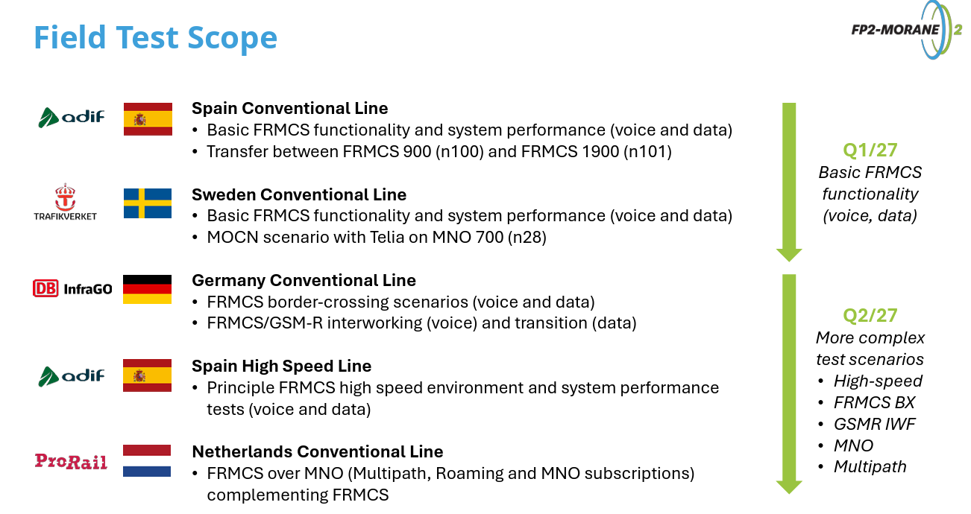
FP2 - MORANE-2
Flagship project 2 - MObile radio for RAilway Networks in Europe 2
December 2024 →September 2027
EU Funding: 13,5 Million EUR - Synergy with SNS JU
28 Beneficiaries + Affiliated Entities + Associated Partners
Benefits
Enable a multi-vendor ecosystem, supporting an innovative and competitive market.
Facilitate the migration from GSM-R to FRMCS across Europe and worldwide.
Modernise and digitalise railway operations through 5G Mission Critical FRMCS.
Support strategic use of RMR and MNO frequency bands for the railway sector.
Improve rail services through increased capacity, reliability, and safety.
Pan-European testing campaign of the Version 2 of the Future Rail Mobile Communication System (FRMCS) – the replacement of GSM-R and enabler for future digital functions.
Maturity expected by 2027: Technology Readiness Level 7 (TRL7/8 by end of the EU-RAIL programme)
Control Command and Signalling Technical Specification for Interoperability expected to be updated with FRMCS specifications (tested in field) by 2028 – complementing the ETCS specifications.

Slide 8
Thank you

