Slide 1
SNS JU NTN Activities and Portfolio
Smart Networks and Services Joint Undertaking
Oana Radu, Programme Officer, SNS JU
Online Presentation at the S5LECT final event
Velizy, France, 7 October 2026

Slide 2

SNS JU mandate is to build Europe’s future connectivity ecosystem
Europe's flagship public-private partnership for 6G research and innovation
Brings together industry, academia, and policymakers to develop next-generation network technologies
Underpins the next generation of digital networks and services powering European competitiveness and sovereignty

Slide 3



Why NTN is a Priority for SNS JU
TN-NTN integration is a structural 6G requirement that SNS JU must address to fulfil its mandate
Technological Sovereignty⁽¹⁾
Ubiquitous Coverage
Standardization
6G Architectural
3GPP Rel-17, 18, 19 → 20, 21
Ability to develop, provide, protect, and retain critical technologies
Ability to act and decide independently in a globalised environment
~70% Earth's surface unserved
by terrestrial RAN;
NTN is the only answer
TN-NTN convergence decisions
made at Rel-21 will be
irreversible at deployment
(1) Source: https://www.europarl.europa.eu/RegData/etudes/STUD/2021/697184/EPRS_STU(2021)697184_EN.pdf

Slide 4

TN-NTN integration requires that we answer multiple questions
Key areas: spectrum, sovereignty and security
6G natively integrates satellites, HAPS, UAVs as nodes.
Seamless handovers to maritime, aviation and cross-border areas
FROM
TO
Networks are territorial
Single-Layer Vulnerability
Connectivity as National Infrastructure
TN-NTN Coexistence
NTN cross borders continuously
Traffic routing may bypass national gateways
Multi-Layer Redundancy
Connectivity as Global Utility
TN-NTN Integration
New questions
| USO vs Global service delivery | Lawful intercept | Security |
| Spectrum coordination | Data sovereignty | Licensing |

Slide 5
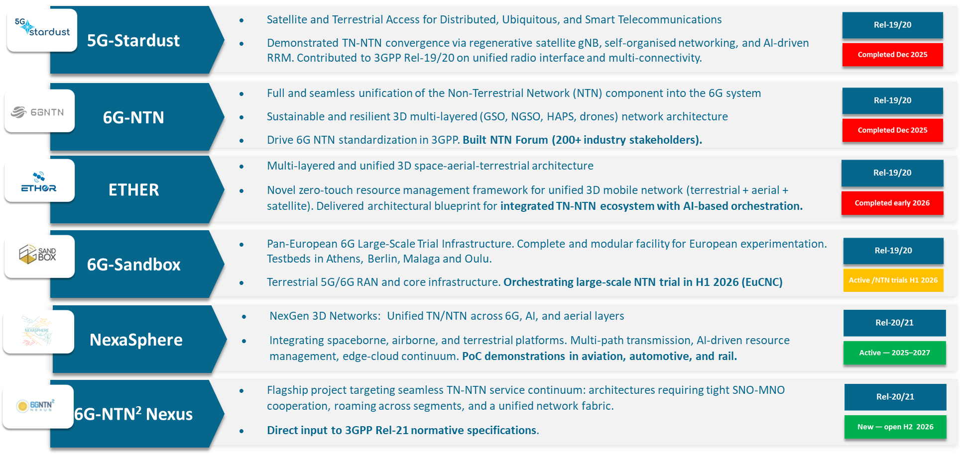
Some of our NTN-related projects

Slide 6
EU-Rail & SNS JU synergy
Support the future connectivity needs of the rail community and help progress the digitalisation of a modern European transport ecosystem
Validates FRMCS V2 and shapes the V3 ecosystem for Europe’s next-generation rail systems
Ensures complementarities between research and innovation agendas rather than establishing fully co-funded joint calls with pooled governance structures

Slide 7
In summary….
The definition of the 6G vision has begun at 3GPP and NTN is recognized as playing a pivotal role in future fully integrated systems.
SNS vision is multilayer and involves the cooperation of terrestrial, airborne and space nodes.
A complex landscape for research ahead as each layer of the architecture presents differing challenges.
Europe should not miss this opportunity to be at the forefront of the next frontier in telecommunications.
Our goal now: move from lab validation to real-world NTN trials.

Slide 8
Contact us:

